Slide 1
Tacoma Police Department Complaint Process Presentation
Internal Affairs Section
Lieutenant Gary J. Roberts
Sergeant Steve Storwick
Sergeant Kevin Jepson
Police Administrative Support Specialist Marie Nasworthy (IaPro/BlueTeam Administrator)

Slide 2
Inquiries vs. Complaints
Inquiry
Is a communication which questions the conduct or performance of any member, or the Department. Usually an inquiry is a question involving the reason or justification of the delivery of service or procedure used by a member of the Department.
Complaint
Is any communication, verbal or written, specifically conveying dissatisfaction with the performance or conduct of the Department or members of the Department or alleging misconduct or unlawful acts by members of the Department. Complaints may be handled at the bureau level or referred to Internal Affairs as appropriate.

Slide 3
Classifying Complaint Investigations
Bureau Level Investigations
If sustained, a Bureau Level investigation can result in counseling, verbal warnings, oral reprimands, and written reprimands. Documentation is maintained for a period of one year then destroyed. Bureau Level Written Reprimands are archived* after 2 years if there are no other similar sustained incidents.
Department Level Investigations
If sustained, are placed in employee’s personnel file and archived* after 5 years if there are no other incidents of equal or greater severity resulting in discipline. Discipline for sustained complaints can range from written reprimands, economic sanctions to termination.
* Current WA State retention law is 10 years past officer’s separation from department

Slide 4
Complaint Dispositions
Sustained Is a final disposition of a complaint when it is determined the Department member acted improperly with respect to the Department policy.
Not Sustained Is a final disposition of a complaint when the investigation is unable to substantiate whether or not misconduct or violation of policy or procedures occurred.
Unfounded Is a final disposition of a complaint when the investigation revealed that the facts or actions alleged did not occur.
Exonerated Is a final disposition of a complaint when the investigation revealed that the facts or alleged actions were substantially correct; however, the conduct of the Officer was proper given the circumstances.

Slide 5
Progressive Discipline
Progressive Discipline
The concept of progressive discipline involves an attempt to re-train improper behavior using the least severe form of corrective action necessary and progressing through ascending stages of discipline when lesser forms have not succeeded in correcting the behavior. This concept does not imply that all situations must be dealt with by using every step in the process. Some incidents, because of the seriousness of the violation, may require more severe disciplinary actions beyond the initial steps.
Mistakes versus Misconduct

Slide 6
How Complaints Are Received
In-person
Phone in: (253) 591-5283 Internal Affairs line
Via South Sound 911 (253) 287-4455
Via U.S. Mail
Via Email (TPD-IA@cityoftacoma.org)
Via a compliance agency (Department of Justice, E.E.O., Washington State Attorney General’s Office, Outside agencies)
Online: City of Tacoma TacomaFIRST 311
City Manager’s Office, Elected Officials
Officer Self-Reports (violation from BWC or Arrest etc.)
Duty to Intervene (UoF or Other allegation)
BWC (Supervisors reviewing uses of force etc.)

Slide 7
Anonymous Complaints
From time-to-time anonymous complaints are received. (No contact information for follow-up etc.)
However, the anonymous complainant must supply enough details in order for the complaint to be investigated
Example of a vague complaint: “TPD is harassing me” versus “I saw officer driving patrol vehicle #123 assault a subject that was driving a blue Chevrolet, License #123ABC”

Slide 8
Common Inquiries and Complaints
Can we do what we did?
Why we did what we did?
Why didn’t we do what they thought we should do?
A number of inquiries made by community members are a result of unrealistic expectations, a misunderstanding or a lack of knowledge in what we do, how we do it or who did it; (i.e. Complaints against SS911 Call Operators) Contact a South Sound 911 supervisor (253) 287-4455

Slide 9
Common Inquiries and Complaints
Courtesy (rudeness, profanity)
Driving
Insubordination
Unsatisfactory Performance
Unbecoming Conduct
Truthfulness (Brady decision, PIE)
Off-Duty conduct
Computer misuse (improper use of databases and social networking sites)
Abuse of Power
A majority of internally generated complaints are sustained (employee/supervisor complainants)

Slide 10
On-Duty vs. Off-Duty
Employees can be held responsible for their actions while off-duty
TPD employee’s conduct, while in an off-duty capacity, could result in discipline by the department
If working off-duty, officer will follow TPD Policy and Procedures (other off-duty work requirements)
With social media, a direct nexus to the department is not necessary for there to be a violation (1st Amendment rights are not absolute with police/public employees)

Slide 11
IAPro/BlueTeam Management System
IAPro/BlueTeam tracks all Complaints, Inquires, Uses of Force, Pursuits, and Vehicle Accidents
IAPro/BlueTeam is a computer program/database that allows for reports & queries to be generated from information entered into the system
Routings can’t be deleted, changed etc.
C.A.L.E.A. (Commission on Accreditation for Law Enforcement Agencies) requires yearly reports & reviews
Includes Early Intervention System - a tool used to identify and support employees who demonstrate characteristics that may affect job performance – not punitive

Slide 12
Early Intervention Thresholds
Indicator Criteria | Threshold Levels CALEA 35.1.9(a)
A. Use of Force | 7 or more within 6 months
B. City Vehicle Accidents | 3 accidents within 24 months
C. Receipt of a Blue Team, Department or EEO Complaint CALEA 35.1.9 (b) | 3 or more within 12 months
D. Pursuits | 4 or more within 6 months
E. Receipt of commendations and awards | Reviewed by the Chief’s office for consideration of additional recognition
F. Supervisory Recommendation | Each will be reviewed

Slide 13
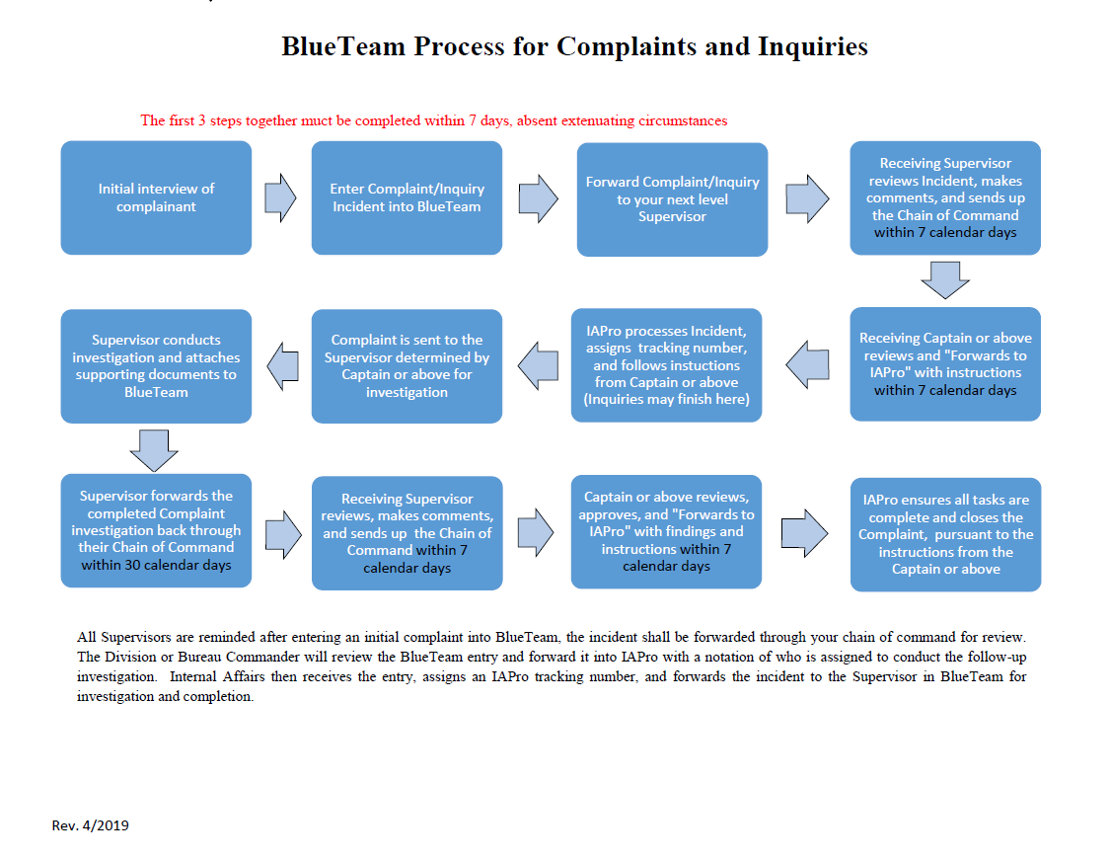

Slide 14
What is the Bureau Level Complaint Process?
NOTE: A typical chain of command routing through BlueTeam is the Bureau Sergeant to Lieutenant, to Captain, to A/C, and back to IAPro/BlueTeam Administrator (noted as IA)
Complaint received and a brief synopsis (not investigation) is entered into BlueTeam by the supervisor
Routed through the chain of command to determine the appropriate investigator. Routed back to IA with instructions for investigation
Is it an Inquiry?
Bureau Level or I.A. Level?
IA sends complaint via BlueTeam to the supervisor for investigation

Slide 15
Once investigation is complete, the supervisor routes it back through the chain of command for review, findings and discipline/training if appropriate. Does it need additional investigation? Ultimately, routed back to IA
Once the completed complaint investigation is back to IA, IA summarizes the various documents of the investigation into a formal memorandum. IA and the ASB Assistant Chief review the investigation which can be sent back to the Bureau if needed for additional investigation
The memorandum is forwarded to the Chief of Police (COP). If approved, COP forwards summary to City Manager’s Office (CMO)

Slide 16
If CMO approves complaint investigation, CMO sends formal letters to complainant regarding disposition/findings – Discipline is not addressed – IA Phone # is noted on the CMO’s letter
IA coordinates discipline documents and/or training and routes those as appropriate for completion
Community’s Police Advisory Committee (CPAC) reviews investigation dispositions sent by CMO
Once a complaint is completed through the CMO, a resolution letter is sent from IA to the involved employee and the complaint is formally closed

Slide 17
Community Member Complaints
Bureau Supervisors investigate most complaints
In 2021 there were 180 allegations (92 complaint investigations) against department members. There were 124,105 calls for Police Service including self-initiated (subject stops, traffic stops, pro-active policing such as Problem Oriented Policing (POP).
FINDINGS: 70 were Exonerated, 37 were Not-Sustained, 51 were Unfounded, 16 were Sustained, and 6 were Pending

Slide 18
Community Member Complaints
Comparable 2022 Complaint Raw Data Comparison
In 2022 there were 130 allegations (86 complaint investigations) against department members. There were 148,836 calls for Police Service including self-initiated (subject stops, traffic stops, pro-active policing such as Problem Oriented Policing (POP).
FINDINGS: 39 were Exonerated, 53 were Not-Sustained, 26 were Unfounded, 8 were Sustained, and 4 are Pending

Slide 19
2021 & 2022 Complaints
 | 2021 | 2022
Calls for Service | 124,105 | 148,836
Total Community Member Generated Allegations / Complaints | 180 / 92 | 130 / 86
Sustained | 16 | 8
Unfounded | 51 | 26
Exonerated | 70 | 39
Not-Sustained | 37 | 53
Internally Generated Complaints
Year | 2021 | 2022
Totals | 49 | 29

Slide 20
Questions?

